Slide 1
Learning Agency Exercise
Students Test Dataset Analysis
Akshay Umashankar

Slide 2
Task
Analyze a particular trend or pattern within the dataset using your preferred programming language
Analysis:
Regression analysis of Percentile on University, Program Name, Specialisation, Domain, and Semester
Dataset split into a training and testing set for evaluation

Slide 3
Overview
Independent Variables
University, Program Name, Specialisation, Domain, Semester
Dependent Variables
Percentile
Assumptions
Independence
Uniform Distribution
Limitations
Limited Data
Python – Jupyter Notebook

Slide 4
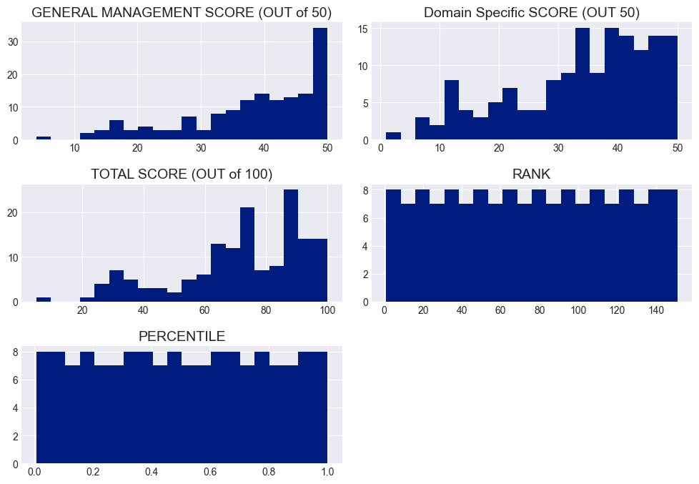
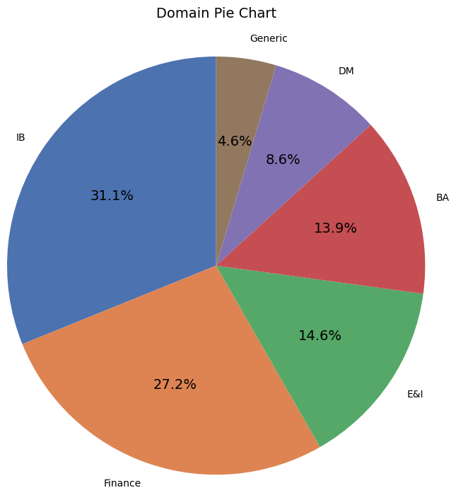
Descriptives

Slide 5
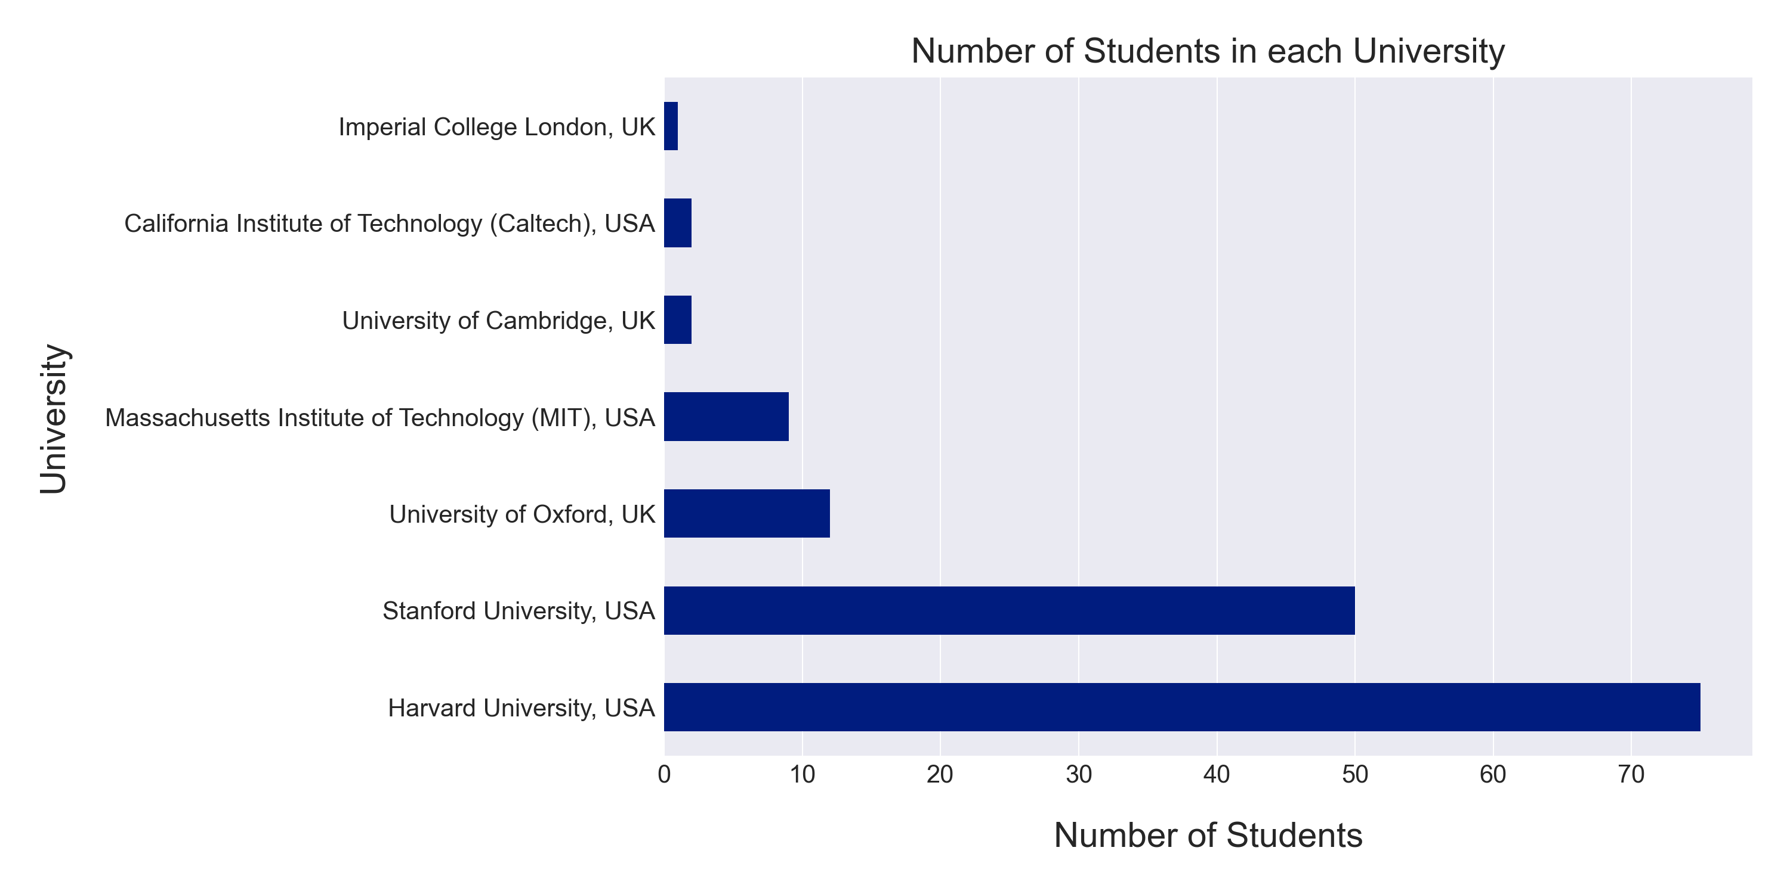
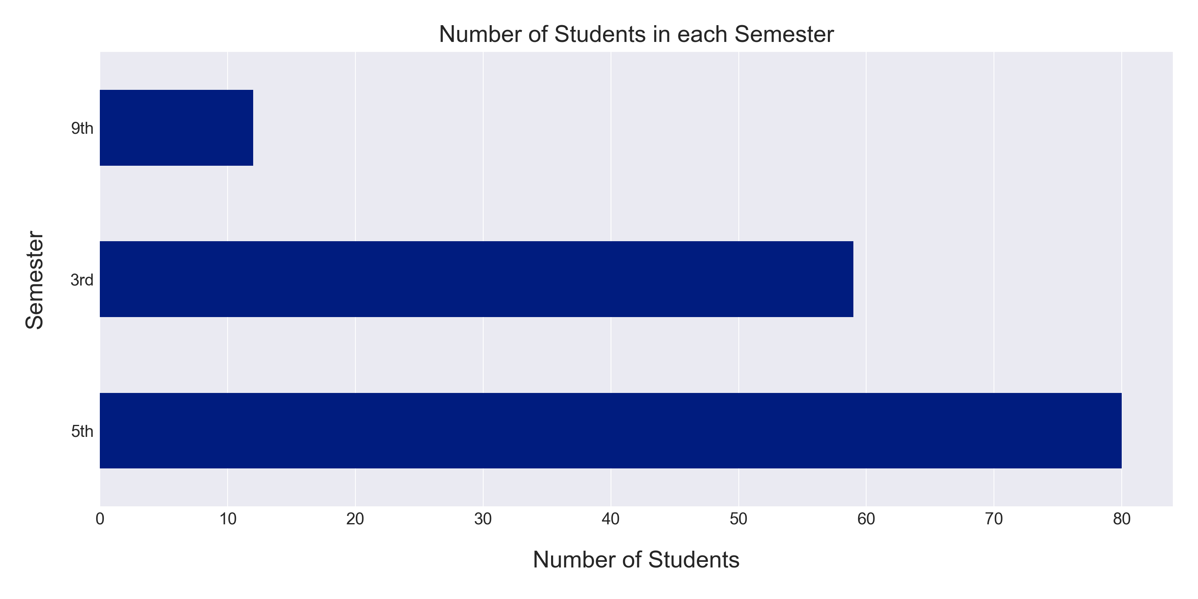
Descriptives

Slide 6
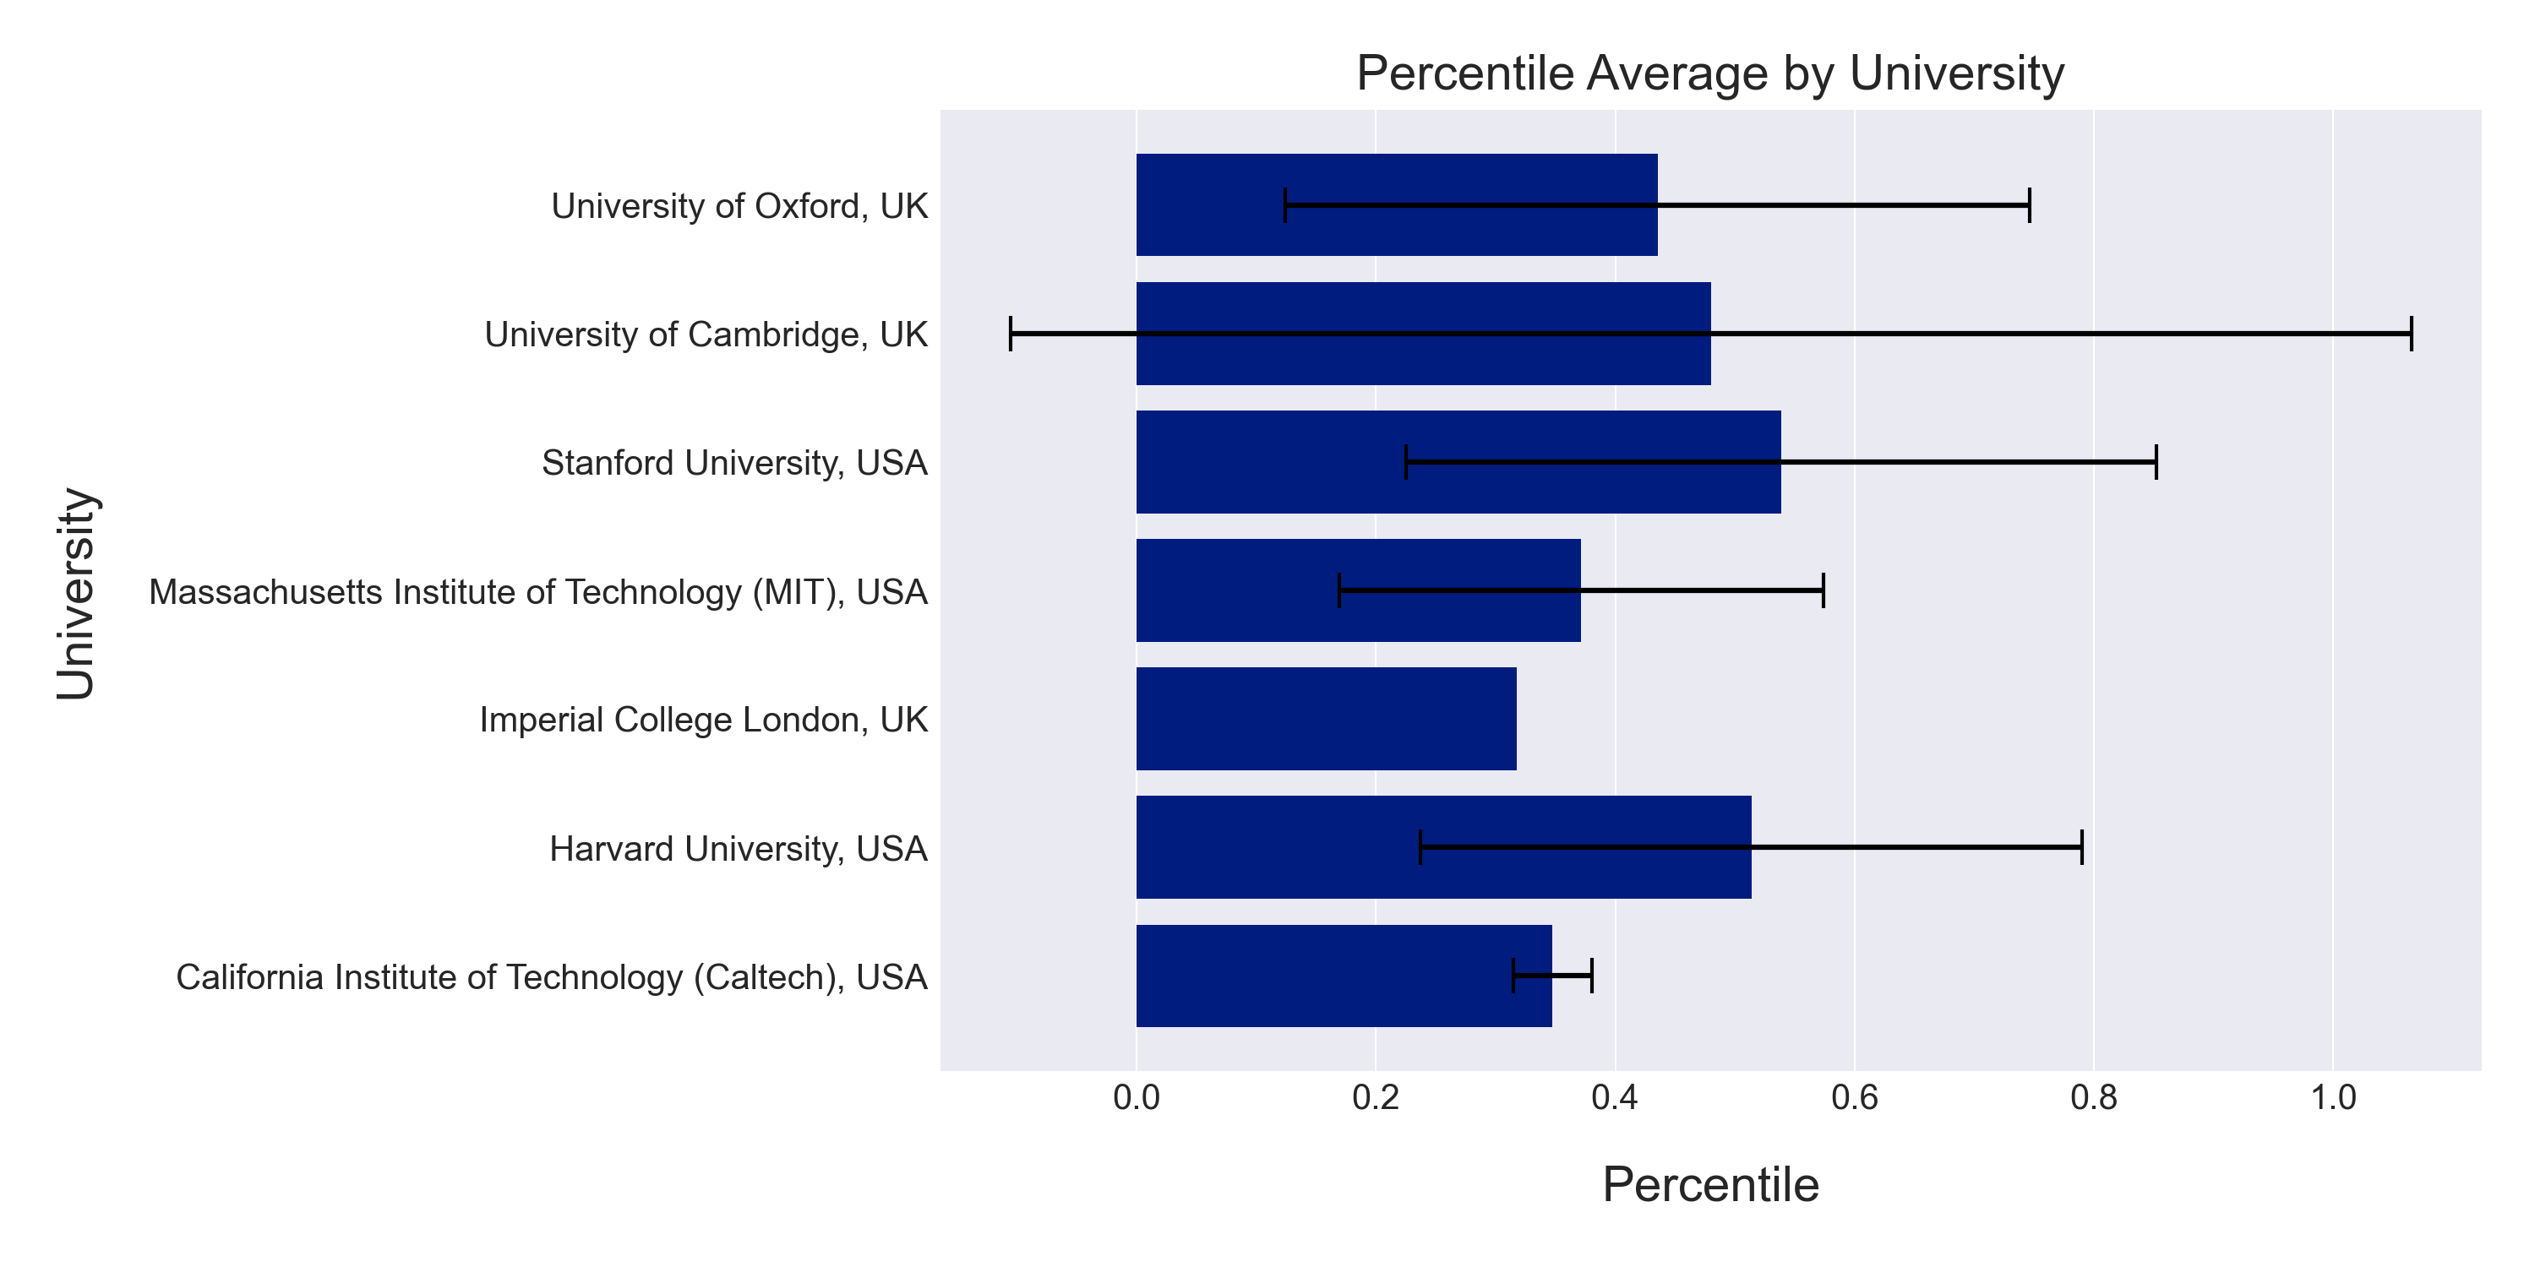
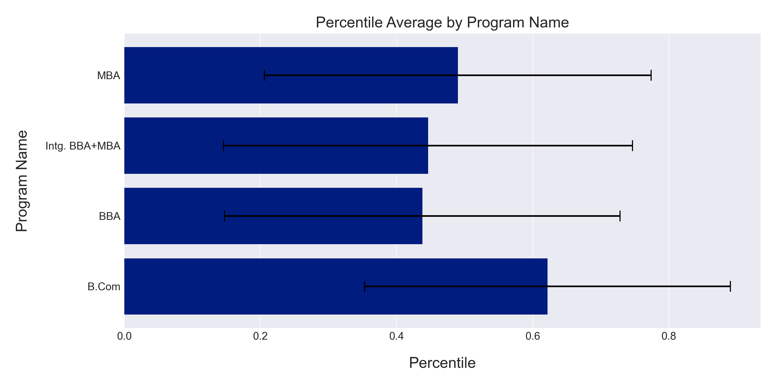
Grouped Graphs

Slide 7
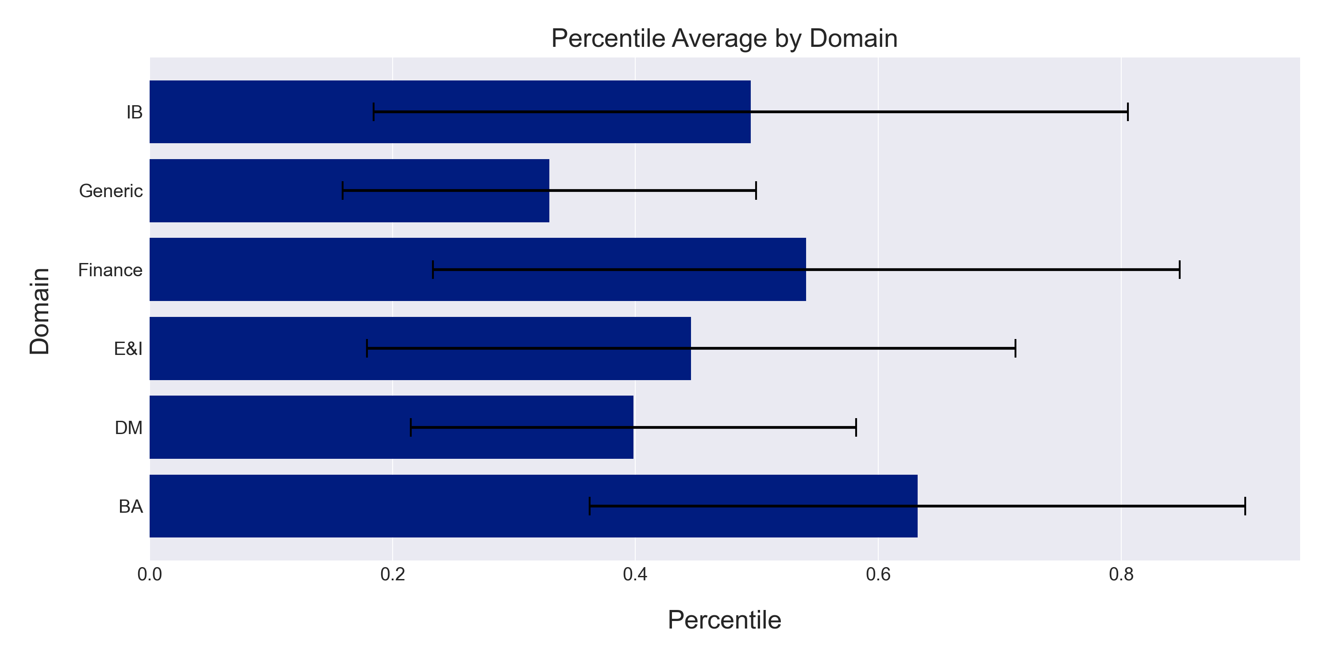
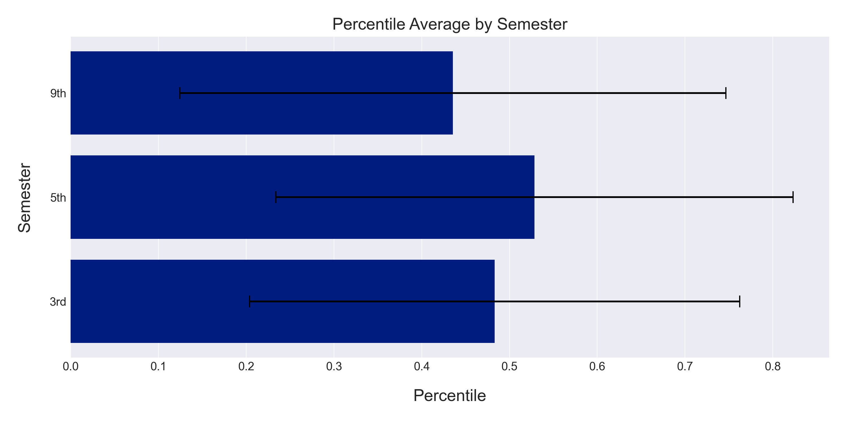
Grouped Graphs

Slide 8
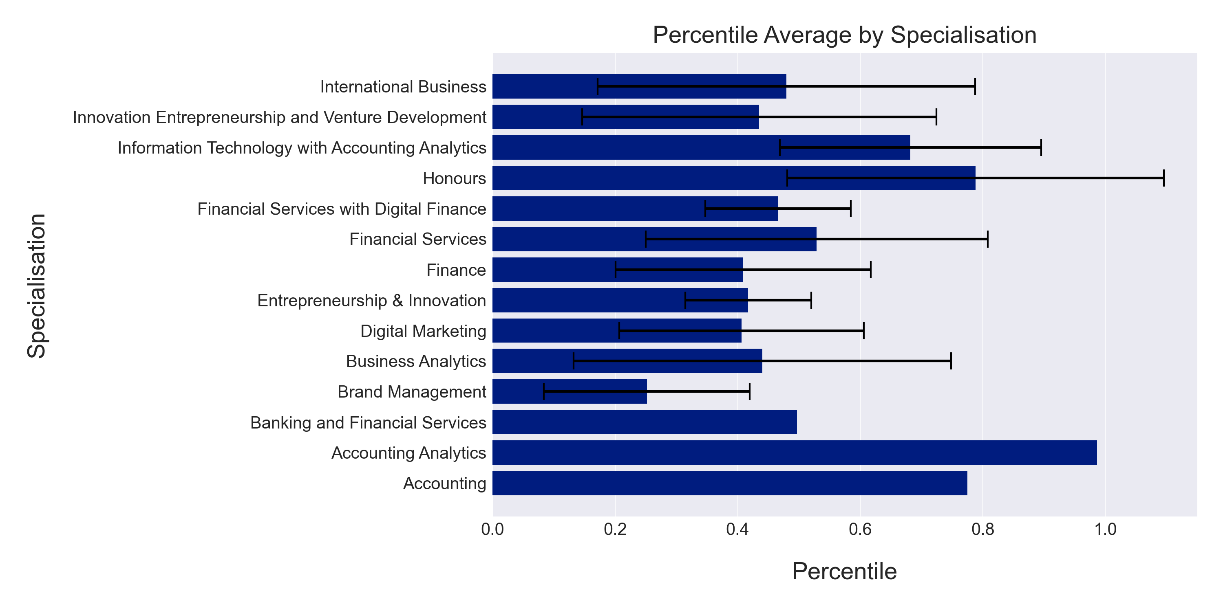
Grouped Graphs

Slide 9
Regression Analysis
Linear Regression
Semester converted to Numerical (3, 5 and 9)
Categorical Values dummy coded using scikit-learn Ordinal Encoding method
Standardized using scikit-learn Standard Scaler
Results
RMSE =~ 0
R² = 1

Slide 10
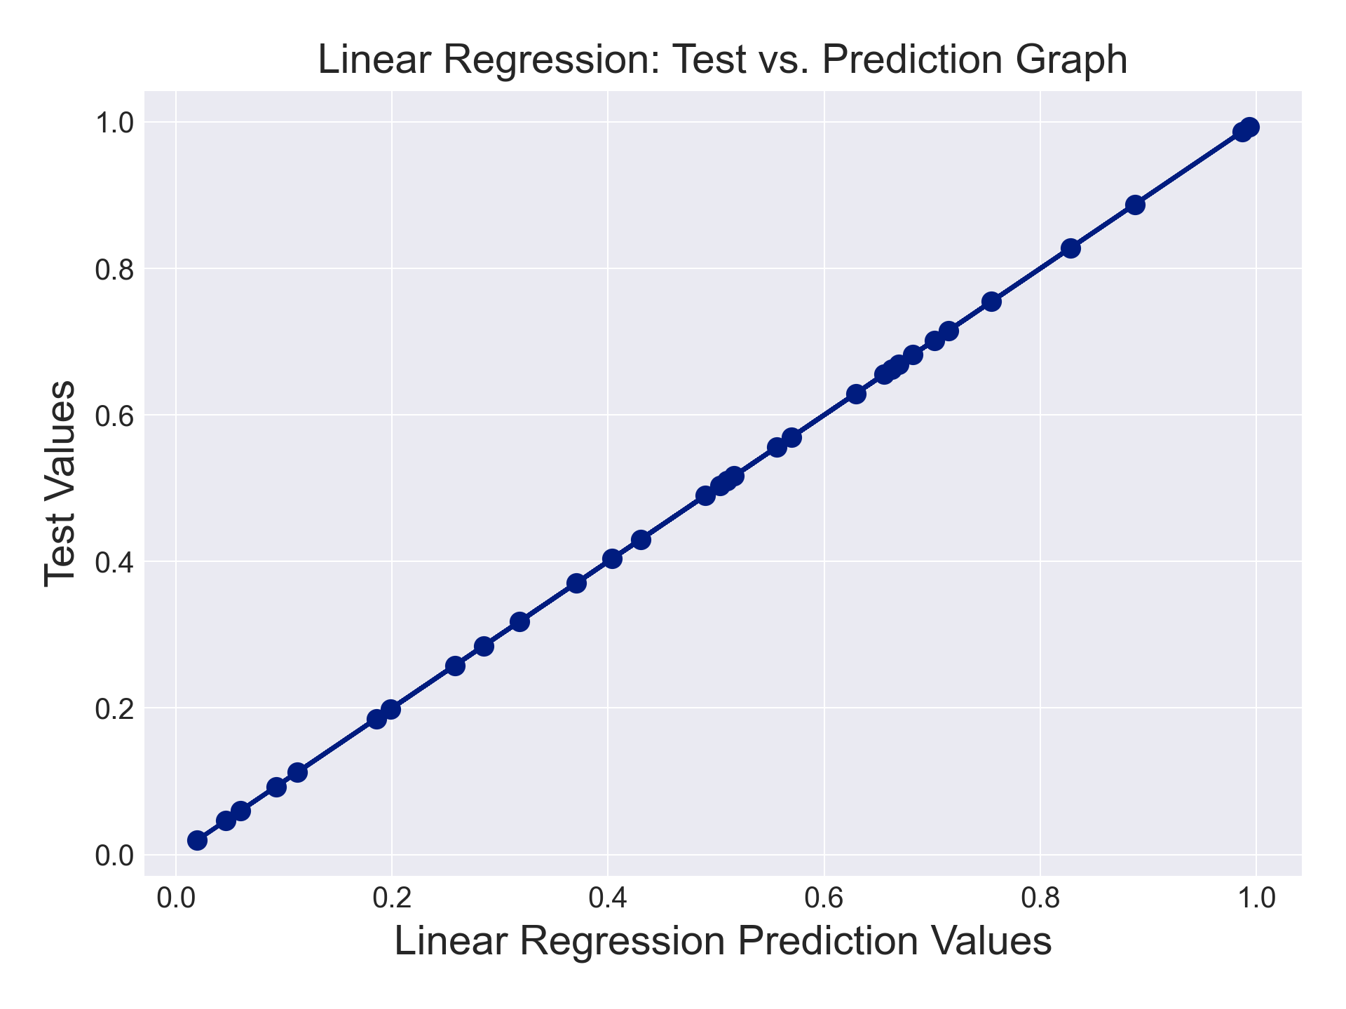
Regression Analysis
Linear Regression
Semester converted to Numerical (3, 5 and 9)
Categorical Values dummy coded using scikit-learn Ordinal Encoding method
Standardized using scikit-learn Standard Scaler
Results
RMSE =~ 0
R² = 1
Overfitting

Slide 11
Regression Analysis
Stochastic Gradient Descent Regression
Semester converted to Numerical (3, 5 and 9)
Categorical Values dummy coded using scikit-learn Ordinal Encoding method
Standardized using scikit-learn Standard Scaler
1000 iterations
Results:
RMSE = 0.003
R² = 0.961

Slide 12
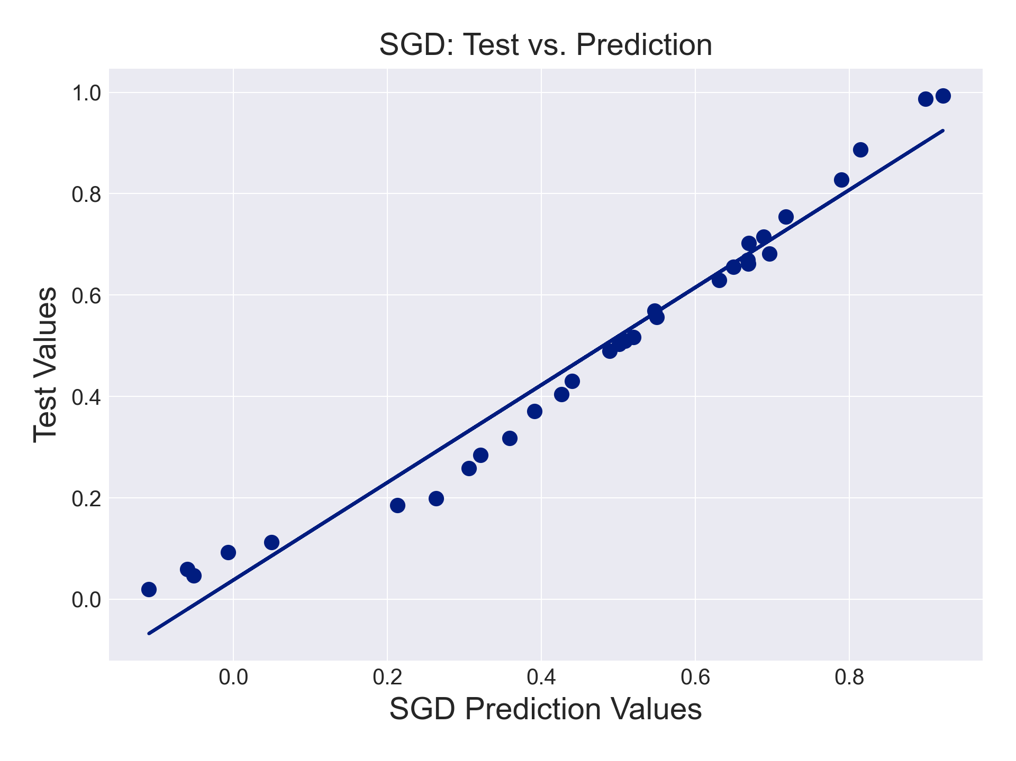
Regression Analysis
Stochastic Gradient Descent Regression
Semester converted to Numerical (3, 5 and 9)
Categorical Values dummy coded using scikit-learn Ordinal Encoding method
Standardized using scikit-learn Standard Scaler
1000 iterations
Results:
RMSE = 0.003
R² = 0.961
Reasonable Model

Slide 13
Thank You
Jupyter Notebook will be included in submission through GitHub

